Slide 1
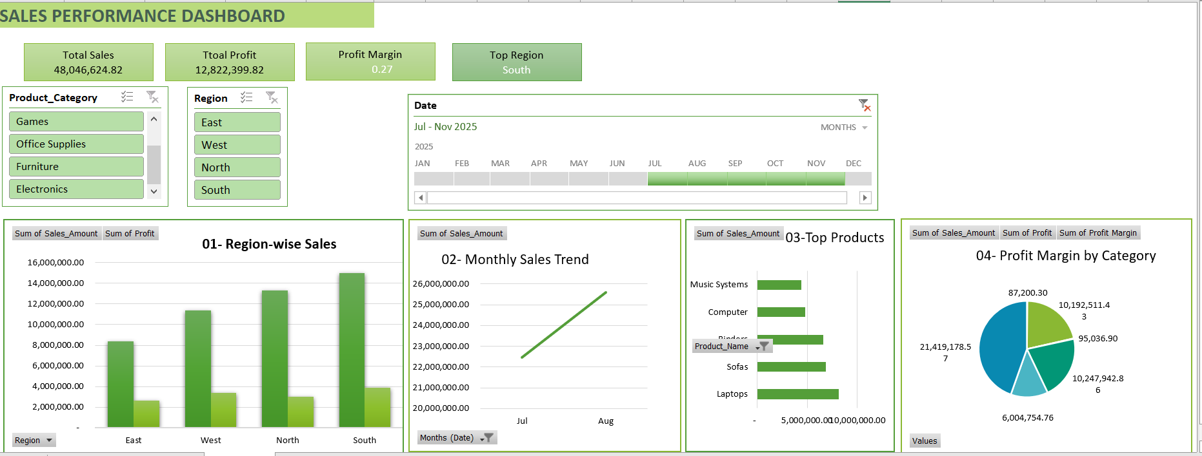
SALES DASHBOARD
Objective
To analyse region-wise sales and profit trends across regions and product categories over a short 2-month period
Track KPI’s like total sales, profit Margin and highest sales region.
Help decision-makers understand trends and make better choices
KPIs Tracked
Total Sales
Total Profit
Profit Margin
Top Region by Sales
Monthly Sales Trend
Key Insights
South Region had highest Sales with High Profit Margin
July shows lowest Sales due to seasonal dip
Electronics Category was most Profitable
Dataset Review
2 months of data
50 records
Includes: Date, Region, Category, Sales, Cost, Profit, Product
Tools used- Excel
Pivot Tables
Pivot Charts
Slicers
KPI Summary Cards
Conditional Formatting

